Slide 1

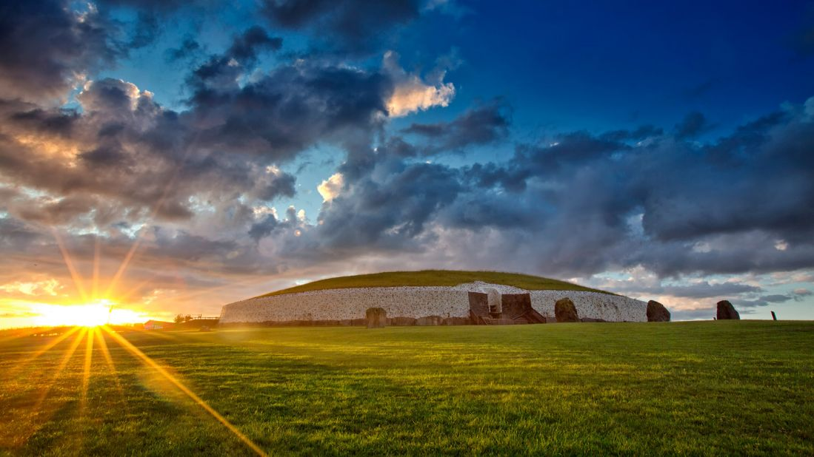


Chapter 2
THE ARCHAEOLOGIST
the archaeologist
Strand One: The Nature of History
@MsDoorley

Slide 2
Learning Outcomes
  1.3 APPRECIATE their cultural inheritance through recognising historically significant places and buildings and discussing why historical personalities, events and issues are commemorated
  1.5 INVESTIGATE the job of the historian, including how they find and use evidence to form historical judgements which maybe revised and reinterpreted in the light of new evidence
  1.6 DEBATE the usefulness and limitations of different types of primary and secondary sources of historical evidence, such as written, visual, aural, oral and tactile evidence; and APPRECIATE the contribution of archaeology and new technology to historical enquiry.
Strand One: The Nature of History
Chapter Two: The Archaeologist
@MsDoorley

Slide 3
Introduction
Archaeology is essential to our understanding of history. As we know, history uses many types of sources to learn about the past, including written, visual, aural and oral. However, only part of history can be told using these sources. We also need evidence for the early history of people - our prehistory, or the time before writing - and this comes from material and tactile things such as artefacts and bodies. In this chapter, we will learn about the important job of the archaeologist.
Strand One: The Nature of History
Chapter Two: The Archaeologist
@MsDoorley

Slide 4
Chapter 2
2.1: WHAT IS ARCHAEOLOGY?
2.1: What is Archaeology?
Strand One: The Nature of History
@MsDoorley

Slide 5
Archaeology
  Archaeology is the study of the remains left by people in the past. To gather this information, archaeologists use excavation; the process where archaeologists dig up the ground to find evidence left by people in the past.
  Archaeology is our only source of information about prehistoric times, so a lot of archaeology focuses on that era - however investigations of more recent times are used to help historians build a complete picture of what life was life for people in the past.
Strand One: The Nature of History
Chapter Two: The Archaeologist
@MsDoorley

Slide 6
How archaeologists find sites...
  Archaeologists excavate sites for various reasons:
    Ruins and old buildings: Sometimes these are still visible and it can be decided that they might be worth a closer look. For example Bective Abbey in Co. Meath.
    An aerial photograph is a photograph taken of the ground from an elevated position, such as from a helicopter, drone or crane. This helps us ancient structures that may not be seen at ground level. For example, the Hill of Tara in Co. Meath.
    Research archaeology: primary sources such as documents, maps and other records might reveal that a building or structure once existed on the site which might prompt archaeologists to investigate.
    Rescue archaeology: Before one can get planning permission for a new road or building, one has to make sure there is no evidence on the site that will be lost forever. Before the M3 motorway was build in Co. Meath, a total of 126 sites between Clonee and Kells were excavated.
    Accident: Sometimes archaeologists sites are discovered purely by accident. For example, the Ardagh Chalice was found by accident when a farmer was ploughing his field.
Strand One: The Nature of History
Chapter Two: The Archaeologist
@MsDoorley

Slide 7
How evidence is preserved...
  Evidence such as bodies and artefacts can be preserved for thousands of years if the conditions are right.
    As a general rule; when both air and moisture are present, things decay rapidly.
  However, the extreme heat of deserts dries out objects quickly and can prevent decay, preserving them.
  When bodies are buried in airtight coffins or sealed tombs – or volcanic ash as occurred in Pompeii – the airless conditions slow decay.
  European peat bogs preserve bodies extremely well due to the combination of cold, acidic water and airlessness below water level.
Strand One: The Nature of History
Chapter Two: The Archaeologist
@MsDoorley

Slide 8

Checkpoint Questions (pg. 12, Artefact 2nd Edition)
  Define the term excavation.
  Define the term aerial photograph.
  List five ways archaeologists find sites to excavate.
  List three ways that evidence can be preserved.
Strand One: The Nature of History
Chapter Two: The Archaeologist
@MsDoorley

Slide 9
Checkpoint Questions (pg. 12, Artefact 2nd Edition)
  Excavation: when archaeologists dig up the ground to find evidence left by people in the past.
  Aerial photograph: a photograph taken of the ground from an elevated position, for example from a helicopter or drone.
  Ruins of a building, aerial photography, research archaeology, rescue archaeology, by accident.
  The extreme heat in a desert, airtight conditions, European peat bogs.
Strand One: The Nature of History
Chapter Two: The Archaeologist
@MsDoorley

Slide 10
Chapter 2
2.2: THE JOB OF THE ARCHAEOLOGIST
2.2: The Job of the Archaeologist
Strand One: The Nature of History
@MsDoorley

Slide 11
Excavating Sites
  When they find a site to excavate, archaeologists:
  Carry out a survey to see if the site is worth excavating.
  Dig test trenches; a sample hole dug to see if there is anything of interest present and judge if it is worth excavating the whole site.
  Remove the topsoil (the topmost, most recent layer of soil) using a digger or pick axe.
  Dig very carefully to make sure they do not damage anything, using trowels and shovels for smaller amounts of soil.
  Use brushes to remove soil delicately from any objects found.
  Use sieves to ensure nothing is thrown away in the soil.
  Record the position of every artefact found – everything is carefully drawn and photographed.
  Catalogue the details of each artefact on computers and in the excavation’s site book.
  Put the artefacts into separate, labelled bags and then boxes which are numbered and sent to laboratories for tests.
  Once the tests are finished, artefacts are usually brought to museums where they can be displayed for people to learn from.
Strand One: The Nature of History
Chapter Two: The Archaeologist
@MsDoorley

Slide 12
Checkpoint Questions (pg. 13, Artefact 2nd Edition)
  Name three tools used by archaeologists.
  List all the steps involved in excavating a site.
  Why do archaeologists have to be careful when excavating?
Strand One: The Nature of History
Chapter Two: The Archaeologist
@MsDoorley

Slide 13
Checkpoint Questions (pg. 13, Artefact 2nd Edition)
  Any three of: trowels, shovels, brushes, sieves.
  Survey; dig test trenches; remove topsoil; use trowels and shovels; use brushes to remove soil from objects; use sieves to catch small items; record the position of every artefact found; draw the artefacts; photograph the artefacts; catalogue on a computer and in the site book; put items into separate, labelled bags and boxes; send items to laboratory for tests.
  To make sure they do not damage anything.
Strand One: The Nature of History
Chapter Two: The Archaeologist
@MsDoorley

Slide 14
Chapter 2
2.3: SKILLS AND METHODS USED IN ARCHAEOLOGIST
2.3: Skills and Methods Used in Archaeologist
Strand One: The Nature of History
@MsDoorley

Slide 15
Skills and Methods Used In Archaeology
  Archaeologists use various skills and methods when carrying out their work. These include skills used to locate information within sites as well as many different methods of dating artefacts or any remains that are found.
  We are going to look at:
    Radio-Carbon Dating
    Geophysical Surveying
    Pollen Analysis
    Stratigraphy
    Dendrochronology
    DNA Testing, 3D Reconstruction and Bones
    Conservation
Strand One: The Nature of History
Chapter Two: The Archaeologist
@MsDoorley

Slide 16
Radio-Carbon Dating
  All living things – humans, animals and plants – contain a substance called carbon-14 when they are alive.
  After death, the level of carbon-14 in the once-living tissue begins to drop at a steady rate.
  This means that the older the tissue, the less carbon-14 it contains – how little = how old. This is method of dating age is called radio-carbon dating.
Mount Sandel (Mesolithic period; 8,000 – 3,500 BC)
Strand One: The Nature of History
  In the 1970s, archaeologists found Mesolithic (“of the Middle Stone Age”) evidence at Mount Sandel in Co. Derry. They learned that the first people came to Ireland during this period, probably from Scotland across to Northern Ireland on wooden boats.
  At this time, most of Ireland was covered in dense forest so the earliest settlements were near the coasts or rivers. These people were hunter-gatherers; they hunted animals and gathered berries and nuts, but had not yet learned how to farm.
  Using radio-carbon dating, evidence was dated back to 7,000 BC – Mount Sandel is between 9,000 and 10,000 years old!
Chapter Two: The Archaeologist
@MsDoorley

Slide 17
Geophysical Surveying
  A geophysical survey is like an x-ray of the ground. This allows maps and images of any archaeological evidence underground to be made without an excavation.
  Geophysical surveys can locate artefacts, as well as ruined buildings and structures. This method was used recently to investigate Newgrange, Ireland’s most famous passage tomb at Brú na Bóinne, Co. Meath.
Newgrange Passage Tomb (Neolithic Period, 3,500 – 2,000 BC)
  Newgrange is a Neolithic (“of the New Stone Age”) passage grave, which is older the Great Pyramids in Egypt. The Neolithic Period is when the first farmers came to Ireland. A passage tomb is a narrow passage with one or more burial chambers, made of large stones and covered in earth or stone.
  Until 1962, Newgrange had not been excavated properly. The aim of the geophysical survey was to see whether there were any hidden passageways or chambers – but none were discovered.
  Inside is a passage 20 metres long which leads into a 6-metre high central chamber with three sections. The central chamber has a corbelled roof – a domed roof built by overlapping stones until they meet at the top. A capstone was placed over this. To this day, no water leaks into the chamber – it was a good technique.
  Outside, there is a series of stones surrounding the passage in a circle. Each stone is decorated in spirals and diamonds (Neolithic Art). A large decorated stone sits directly in front of the entrance to the passage tomb.
  Above the passage entrance, there is a gap known as a roof box. Every 21st December – the winter solstice and shortest day of the year – the rising sun shines through this box and lights up the whole passage.
Strand One: The Nature of History
Chapter Two: The Archaeologist
@MsDoorley

Slide 18
Pollen Analysis
  Pollen analysis is the study of pollen remains to find out what was growing at a site during a particular time period. Archaeologists have records of when certain pollens were common so that they can match the pollens to the correct period when excavating.
  Pollen analysis can be used to date objects. It can also tell us when forests were cleared and farming began in an area.
The Céide Fields (Neolithic Period, 3,500-2,000 BC)
Strand One: The Nature of History
Chapter Two: The Archaeologist
  The Céide Fields were discovered by accident in the 1930s by a teacher who, while cutting turf in the bog, noticed a pile of stones. Buried underneath the bog, archaeologists found stone walls stretching for several kilometres. People had lived here between 4,000-3,000 years ago – these would have been the Neolithic farmers. The evidence found here showed them to be organised, protected their animals and divided up the land amongst them.
  The pollen analysis showed a dramatic drop in tree pollens, proving that pine forest areas were cleared to create fields for farming. Amongst the interesting objects found were
  A stone cutting of a primitive plough, a quern used for grinding corn, some arrowheads, pieces of pottery.
  The blanket bog which grew over the fields preserved the site, leaving it in excellent condition for archaeologists to study it.
@MsDoorley

Slide 19
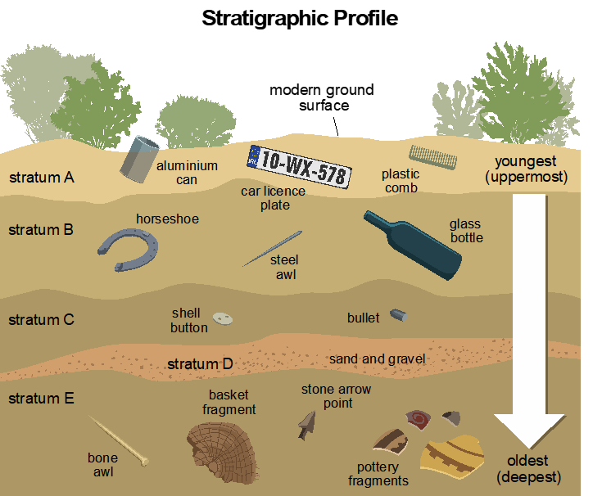
Stratigraphy
  The method of stratigraphy is used to date artefacts and evidence by how deep in the ground they were when found; the deeper they are, the older they will be.
  If you were to drop something today, it would lie on the surface. But over thousands of years, it would become covered by soil, leaves and other matter. Eventually, it would end up buried many meters deep. The method is used in most archaeological excavations.
Strand One: The Nature of History
Chapter Two: The Archaeologist
Diagram taken from Artefact, 2nd Edition by Eimear Jenkinson and Gregg O'Neill (educate.ie)
@MsDoorley

Slide 20
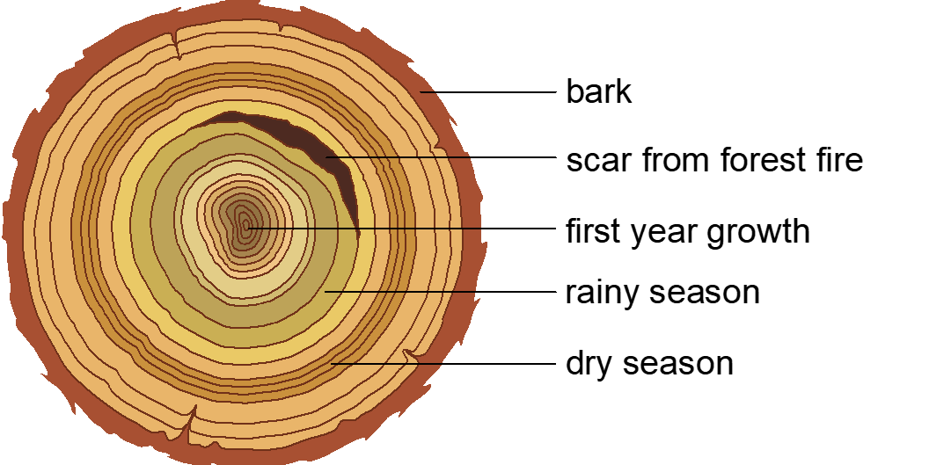
Dendrochronology
  Dendrochronology, also called tree-ring dating, is a method of dating that uses the unique growth patterns of tree rings as a guide.
  If you cut through a tree trunk, you will see rings spreading from the centre outwards - each ring is a year of growth. The rings are wide when the tree grew fast, for example when the summer was good.
  Archaeologists have created a continuous record of tree ring patterns dating back to 5,300 BC.
Strand One: The Nature of History
Chapter Two: The Archaeologist
Diagram taken from Artefact, 2nd Edition by Eimear Jenkinson and Gregg O'Neill (educate.ie)
@MsDoorley

Slide 21
Checkpoint Questions (pg. 17, Artefact 2nd Edition)
  Explain the term radiocarbon dating.
  In what period of history did the first people come to Ireland?
  What were hunter-gatherers?
  Explain the terms geophysical survey and pollen analysis.
  When was the Middle Stone Age?
  Name one archaeological site from the Middle Stone Age.
  Explain the terms stratigraphy and dendrochronology.
Strand One: The Nature of History
Chapter Two: The Archaeologist
@MsDoorley

Slide 22
Checkpoint Questions (pg. 17, Artefact 2nd Edition)
  Radiocarbon dating: a method of dating based on the steadily dropping levels of carbon-14 in tissue over time.
  The Mesolithic period.
  Hunter-gatherers: people who hunted animals for food and gathered berries and nuts.
  Geophysical survey: a survey of what’s underneath the ground, like an x-ray of the ground; Pollen analysis: the study of pollen remains to find out what was growing at a site during a particular time period.
  The Middle Stone Age was the Mesolithic period, between 8,000 and 3,500 BC.
  Mount Sandel, Co. Derry.
  Stratigraphy: a method of dating artefacts and evidence by how deep in the ground they were when found; Dendrochronology: a method of dating that uses the unique growth patterns of tree rings as a guide.
Strand One: The Nature of History
Chapter Two: The Archaeologist
@MsDoorley

Slide 23
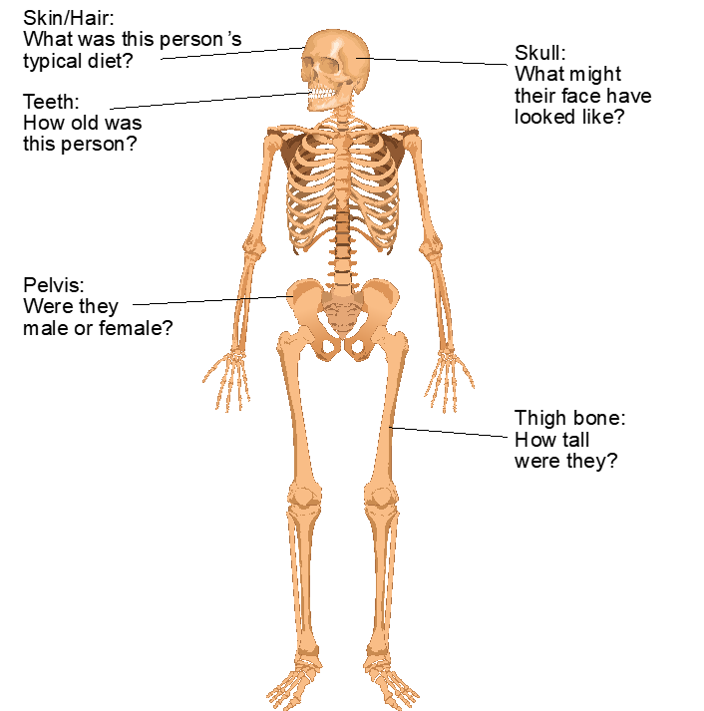
DNA Testing, 3D Reconstruction and Bones
  Archaeologists sometimes find bodies when they excavate sites and modern technology can reveal a lot about these bodies.
  DNA Testing can tell us about the origins and ethnicity of the person – in other words; where they came from and who their people were.
  Another method is 3D reconstruction, or using computer modelling and then clay to reconstruct part of a body. If most of a skull is found, for example, a person’s face can be reconstructed based on their skull structure.
  Archaeologists can also learn a lot by examining bodies:
    The pelvis shows whether the person was male or female
    Teeth can give us a rough idea of a person’s age.
    Bone can show signs of disease or bad nutrition, or if they were damaged it could be that the person’s death was violent.
    The thigh bone is a good indicator of overall height.
    Skin or hair can be analysed for information about typical diet.
Strand One: The Nature of History
Chapter Two: The Archaeologist
Diagram taken from Artefact, 2nd Edition by Eimear Jenkinson and Gregg O'Neill (educate.ie)
@MsDoorley

Slide 24
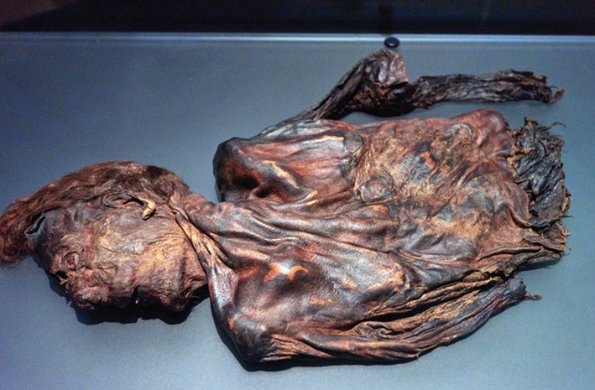
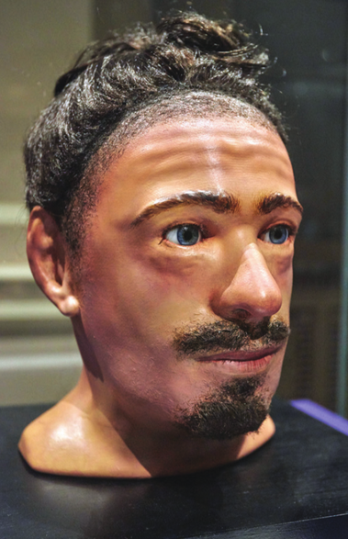
Clonycavan Man (Iron Age, 500 BC – AD 400)
  Clonycavan Man’s body is believed to be 2,300 years old. It dates from the Iron Age, the period when people made tools and weapons from iron.
  He was found in a Co. Meath peat bog in 2003; Only his head and upper body were preserved.
  He had crooked teeth and a thin beard, with the pore visible on his squashed nose.
  We know that his diet consisted mostly of fruit and vegetables.
  His hair style was very distinctive and he used an ancient hair gel made of plant oil and pine resin. Its ingredients came from France and Spain, which shows that he was wealthy.
  Archaeologists think he may once have been a king and was ritually sacrificed. His skull was split by a sharp object, and there was a large cut across his nose and under his right eye. It was estimated that he was aged between 24 and 40 when he died.
Strand One: The Nature of History
Chapter Two: The Archaeologist
Diagram taken from Artefact, 2nd Edition by Eimear Jenkinson and Gregg O'Neill (educate.ie)
@MsDoorley

Slide 25
Conservation
  Conservation is when historical objects are protect and preserved so that they do not decay. Conserving the past benefits us as we can continue to learn about and engage with our history.
  Objects found by archaeologists can be displayed under the correct conditions in museums and heritage sites while documents, maps, photographs and so forth can be safely stored in places such as archives and libraries.
  Historic buildings can also be looked after and restored when necessary, so that they will stay in good condition.
Strand One: The Nature of History
Chapter Two: The Archaeologist
@MsDoorley

Slide 26
Checkpoint Questions (pg. 19, Artefact 2nd Edition)
  Name three things archaeologists can learn from studying the bones of a skeleton.
  Explain the term conservation.
  Give three examples of things that might undergo conservation.
Strand One: The Nature of History
Chapter Two: The Archaeologist
@MsDoorley

Slide 27
Checkpoint Questions (pg. 19, Artefact 2nd Edition)
1. Any three of: the pelvis shows whether the person was male or female; teeth can give us a rough idea of a person’s age; bones can show signs of disease or bad nutrition, or if they are damaged it could be that the person’s death was violent; the length of the thigh bone is a good indicator of overall height; skin or hair can be analysed for information about typical diet.
2. Conservation: when historic objects are protected and preserved so that they do not decay.
3. Documents, maps, photographs.
Strand One: The Nature of History
Chapter Two: The Archaeologist
@MsDoorley

Slide 28
Chapter 2
2.4: SUMMARY & QUESTIONS
2.4: Summary & Questions
Strand One: The Nature of History
@MsDoorley

Slide 29
In this chapter, we have learned that...
  Archaeology is the study of remains left by people in the past.
  An excavation is when archaeologists dig to find evidence left by people in the past.
  Archaeologists identify sites for excavation in various ways; research archaeology, rescue archaeology, visible ruins, aerial photography - and even by accident.
  Evidence can sometimes last a very long time, especially under airless or very dry conditions.
  Steps when carrying out an excavation include: digging test trenches; removing topsoil; using shovels, trowels and brushes; cataloguing all finds; taking photographs; and storing finds in labelled bags and boxes.
  Some skills and methods used by archaeologists are: Radio-carbon dating, Geophysical surveying, Pollen Analysis, Stratigraphy, Dendrochronology, DNA testing, 3D Reconstruction and Bone Analysis.
  Fascinating archaeological discoveries in Ireland include: Mount Sandel, Newgrange, The Céide Fields and the Clonycavan Man.
  The Mesolithic period, the Neolithic period, the Bronze Age and the Iron Age are all periods of history that archaeologists have investigated in Ireland.
Strand One: The Nature of History
Chapter Two: The Archaeologist
@MsDoorley

Slide 30
Exam-Style Questions (pg. 21, Artefact 2nd Edition)
Archaeologists found bones of a Stone Age Child and an adult in tiny cave
Chance discovery is fresh evidence of Knocknarea's Stone Age links
Archaeologists at IT Sligo have found bones of a Stone Age child and an adult in a tiny cave high on Knocknarea mountain near the town. Radiocarbon dating has shown that they are some 5,500 years old, which makes them among the earliest human bones found in the country. The find represents important fresh evidence of Knocknarea's Neolithic (New Stone Age) links and a prehistoric practice known as 'excarnation'.
Researchers discovered a total of 13 small bones and bone fragments in an almost inaccessible cave last November. Three were from the child and 10 were from the adult. They include foot bones and fragments of skull. The adult was aged 30 to 39 and the child 4 to 6 years. It was not possible to establish gender.
'It's an enormously exciting discovery,' said Dr. Maron Dowd of IT Sligo, who is Ireland's only specialist in the archaeology of Irish caves. 'This might seem like a small quantity but it has yielded fantastic results.'
It was a chance discovery by IT Sligo archaeology graduate Thorsten Kahlert while he was investigating a series of little known caves on the slopes of Knocknarea. 'I was surveying one small cave when something on the cave floor caught my eye,' he said. 'I took a closer look and realised it was a human foot bone.' Further examination revealed other bones shrewn on the cave floor.
Dr. Dowd says that small number of bones and their small size suggest that the cave was an excarnation site. That involved a corpse being laid in a cave and, after decomposition, the dry bones being transferred elsewhere. Fragments were sometimes accidentally left behind.
Strand One: The Nature of History
Chapter Two: The Archaeologist
@MsDoorley

Slide 31
SEC Examination Questions
2021 SEC Sample Q2
2022 SEC Q1
2023 SEC Q1
Strand One: The Nature of History
Chapter Two: The Archaeologist
@MsDoorley

